Slide 1

Chapter 12: Runtime Environments
陳奇業 成功大學資訊工程系

Slide 2
Memory of a computer
Register
RAM
- Code Area
- Data Area

Slide 3
General Organization of Runtime Storage
code area
stack
global/static data area
free space
heap

Slide 4
Code Area
code for procedure1
code for procedure2
code for procedure3
.
.
code for procedureN
entry
point
entry
point
entry
point
entry
point

Slide 5
Fully Static Runtime Environments
The simplest kind of a runtime environment is that in which all stat are static, remaining fixed in memory for the duration of program execution.
Such an environment can be used to implement a language in which there are no pointers or dynamic allocation, and in which procedures may not be called recursively.

Slide 6
Each execution of a procedure is referred to as an activation of the procedure. If the procedure is recursive, several of its activation may be alive at the same time.
Activation Record
a contiguous block of storage recording the state of an activation of a function, not all the compilers set the same fields.

Slide 7
What is the contents of the activation record?
temporary values
local data
saved machine status
optional access link to refer to non-local data held in other activation records
optional control link to refer to the activation
actual parameters
returned value

Slide 8
General Organization of an Activation Record
A register top-sp points to the end of the machine status
field in the current top activation record

Slide 9
So, local data are accessed by negative offsets from SP (stack pointer, a register holding a particular position of currently activated procedure).
A local name X can be referenced by X[SP] ([SP] means the address of SP), where X is the (negative) offset for the name from the location pointed to by SP.
Parameter can be referred to by a positive offset from SP. That is, the ith parameter can be referenced by (4+n-i)[SP] (assume each entry takes one unit of space)
positive offsets
negative offsets

Slide 10
Suppose the Memory structure for C program is organized as below, where function P calls Q and Q calls R
0
..
Static area for programs
and global (static) data
(sp)
Top
Extra storage for R
SP
Activation record for R
(fp)
Extra storage for Q
Activation record for Q
Direction
Extra storage for P
of growth
Activation record for P
..
2^{n}-1

Slide 11
TOP is a register holding the top address of the stack. SP is also a permanently allocated register (stack pointer) holding a specific address in the activation record of the currently active procedure. We use SP to indirectly refer to the local variables, parameters, etc.
Extra storage is used for storing pointers on the display, variable-length data such as dynamically allocated arrays, etc.

Slide 12
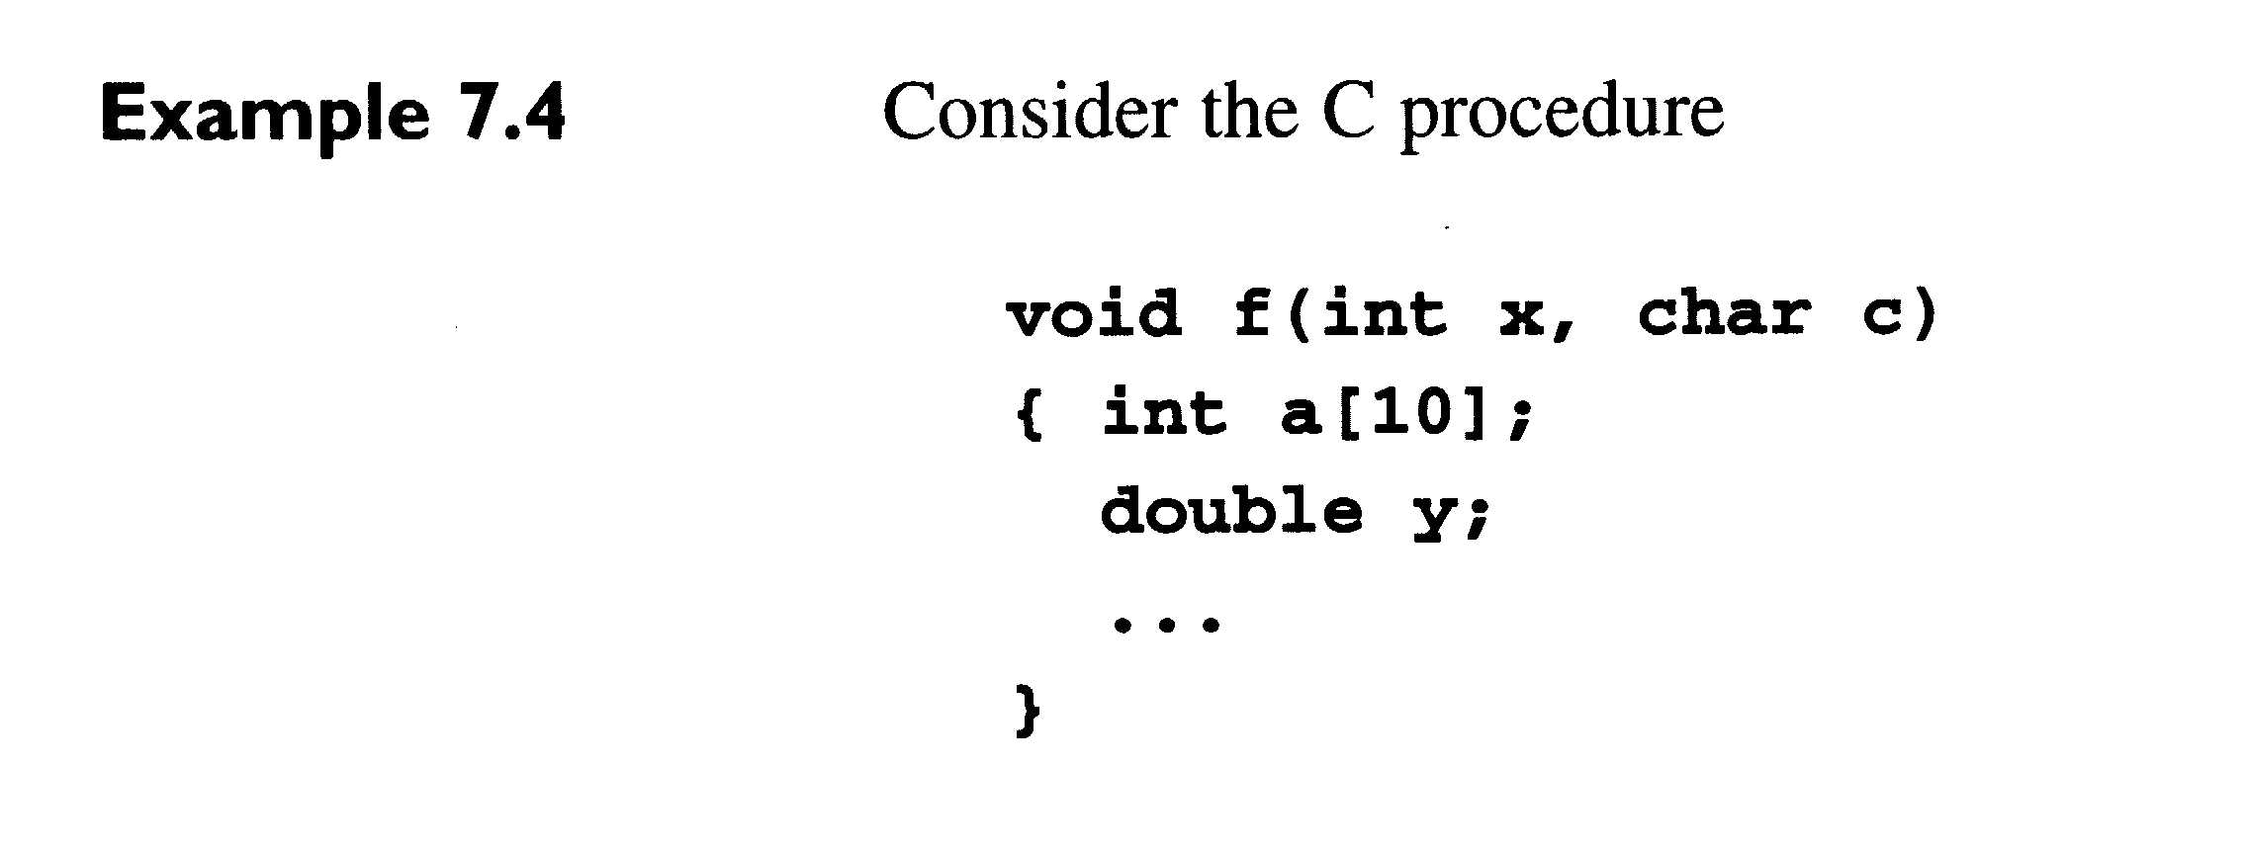

Slide 13
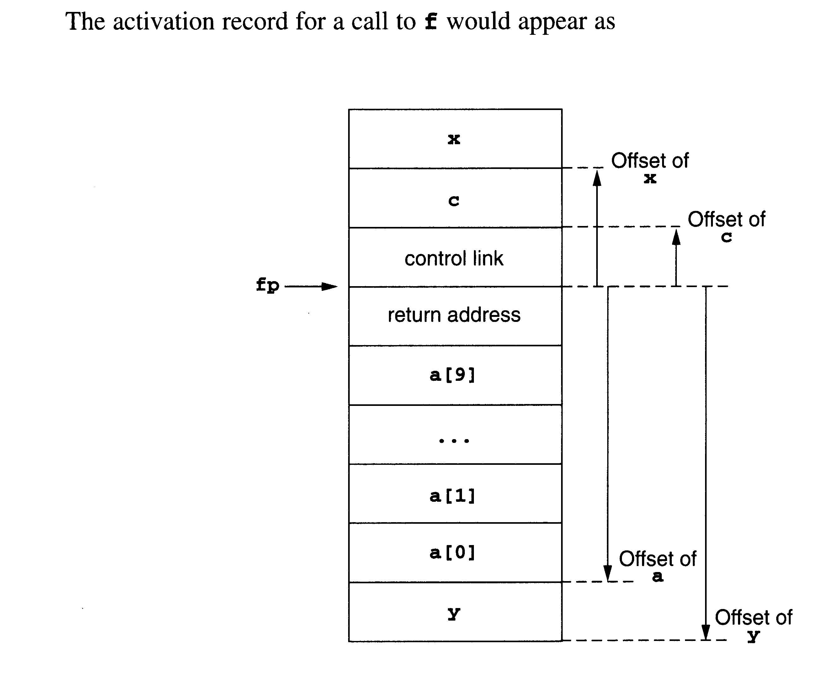
2^{n}-1
Parameter
Growth
direction
Local data
0

Slide 14
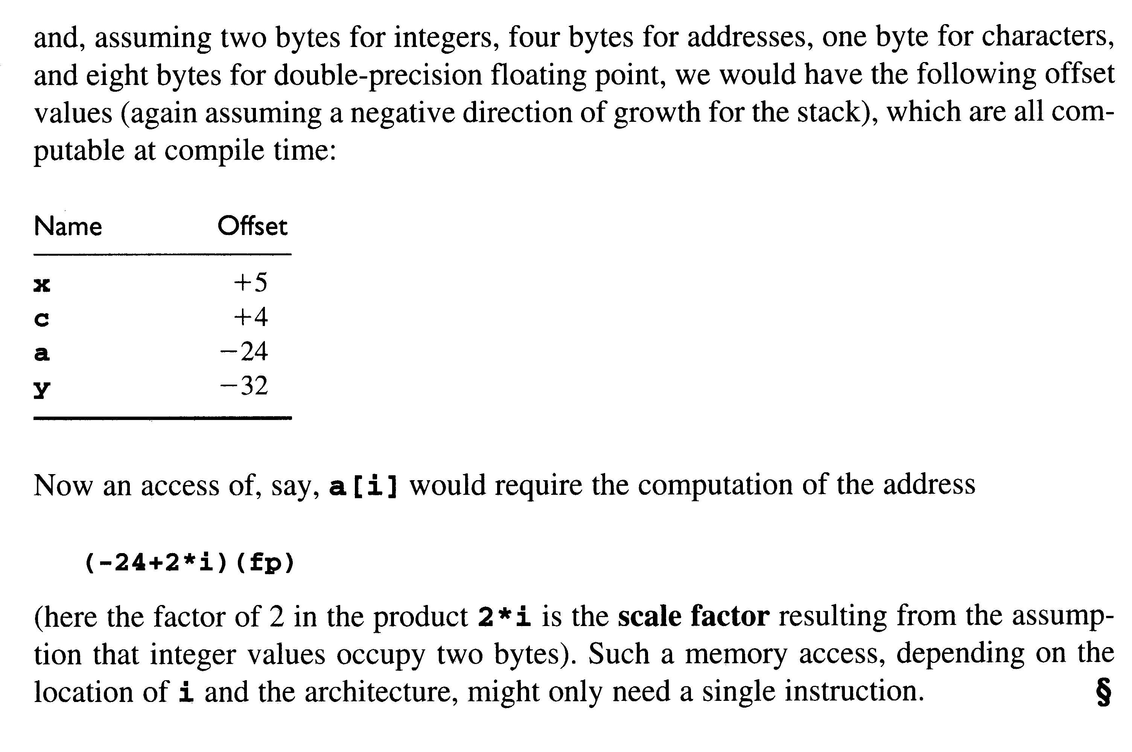

Slide 15
At run-time
e.g. p (T1, T2, ..., Tn) ==> param T1 => push (T1)
param T2 => push (T2)
... ..
... ..
param Tn => push (Tn)
call p, n => push (n)
=> push (l₁)
=> push ()
=> push (SP)
=> goto l₂
l₁ denotes the return address; l₂ denotes the address of the
first statement of the called procedure.

Slide 16
Temporary variable
e.g., p (A+B*C, D) ==> T1 = B * C
T2 = A + T1
Param T2
Param D
Call p, 2

Slide 17
At run-time
* Assume TOP points to the lowest-numbered used location on the stack and the memory locations are counted by words.
'param T' is translated into 'push(T)' which stands for
TOP = TOP - 1; /* now TOP points to an available entry */
*TOP = T; /* save T into the memory
'call p, n' is translated into the following instructions:
push (n) /*store the argument count */
push (l₁) /* l₁ is the return address */
push () /* leave one space for the return value */
push (SP) /* store the old stack pointer */
goto l₂ /* l₂ is the first statement of the called procedure p */

Slide 18
General Organization of an Activation Record
0
Local & temp. data
Old SP
Return value
Return address
Argument count
Parameter t_{n}
.................
Parameter t₂
Parameter t₁
..
TOP
..
Direction
of Growth
caller’s
responsibility
..
2^{n}-1
SP

Slide 19
The first statement of the called procedure
The first statement of the called procedure must be a special three-address code 'procbegin', which (1) sets the stack pointer to the place holding the old SP and (2) sets TOP to the top of the activation record (or the stack), so 'procbegin' stands for:
SP = TOP; // now SP points to old SP value
TOP = SP + size_of_p; /* size_of_p is the size of p,
i.e., the number of words
taken by the local data for
p */

Slide 20
General Organization of an Activation Record
0
TOP
Local & temp. data
Old SP
Return value
Return address
Argument count
Parameter t_{n}
.................
Parameter t₂
Parameter t₁
callee’s duty
..
SP
..
Direction
of Growth
caller’s
responsibility
..
2^{n}-1

Slide 21
The ‘return’ statement
The return statement in c can have the form 'return (expression);'
This statement can be implemented by three-address code to
evaluate the expression into a temporary T followed by:
1[SP] = T /* 1 is the offset for the location of the return value */
TOP = SP + 2 /* TOP now point to the return address */
SP = *SP /* restore SP, SP now points to old location */
L = *TOP /* the value of L is now the return address */
TOP = TOP + 1 /* TOP points to the argument count */
TOP = TOP + 1 + *TOP /* *TOP is the number of parameter of
P. We restore TOP to the top of extra
storage for the activation record below */
go to *L

